Slide 1
PixelPlatformer
Brandon Catalano, Riley Gibson, Madison Goodwin, Elric Flores

Slide 2
Introduction
Our project centers around the creation of a 2D platformer internally titled PixelPlatformer. The features of the PixelPlatformer game are developed on the Godot Engine development environment in tandem with GDScript, Godot’s in-house programming language. Additionally, the game’s core focus is on educating users on basic programming logic.

Slide 3
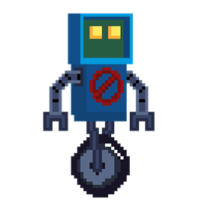
The Problem/Application
We planned to make an application with the goal of teaching users how to code by providing a foundation in logic. This is done through movement commands that are input into a command terminal.
The game includes tile mapping and the character’s animations are made with a sprite sheet. The character the user will control is a small robot.

Slide 4
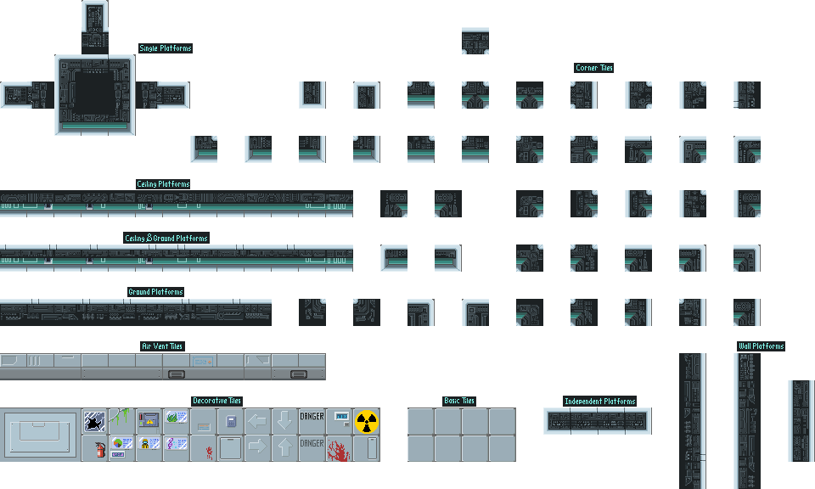
Style and Story
As the name implies, the overall style of the game is pixelated and has a storyline beyond the specific levels of which there are 4. The storyline is loosely based off of the robot’s character escaping his life(e.g. industrial background). As the levels progress, the background becomes organic(e.g. forest and cave backgrounds), hinting at a successful escape. Ultimately though, the character ends up right back where it started, suggesting that his adventure was all but a dream.

Slide 5
Gameplay
Gameplay starts with the robot being chased. The user can do simple movements with the robot using WASD and Spacebar. The robot will soon then trip and fall down a hole into a cavernous area. This new area means the pursuers have lost the robot and are no longer chasing him directly. The fall will hurt the robot character and the user will lose the WASD and Spacebar controls. The screen will fade to black and reappear with a command prompt UI, requiring the user to enter lines of code in order to control the robot.

Slide 6
Movement Mechanics
Command | Action
move_Right() | Moves the robot to the right until stop is specified by stop command.
move_Left() | Moves the robot to the left until stop is specified by stop command.
jump() | Makes the robot jump once. Movement is inherited from the moveRight() and moveLeft() command allowing for platforming.
stop() | Stops the robot from moving left or right using the moveLeft() and moveRight() commands respectively. Does not stop the jump() command as jumps naturally terminate via the forces of gravity.

Slide 7
Audio
This project primarily uses the .mp3 file format to store its audio. The game features a looping song to function as a background track, with a unique song featured in each level. Each of the differing areas have a background track that corresponds with the environment. Additionally, most motions made by the player controlled character, such as jumping or moving left, also has sound effects. When jumping, a thruster sound is made.

Slide 8
Language
The application is developed on the Godot Engine development environment in tandem with GDScript, Godot’s in-house programming language. We chose this environment for our project to explore its ease of use in terms of gaming development. None of the project contributors have worked with Godot Engine before, so it was a new experience for us.

Slide 9
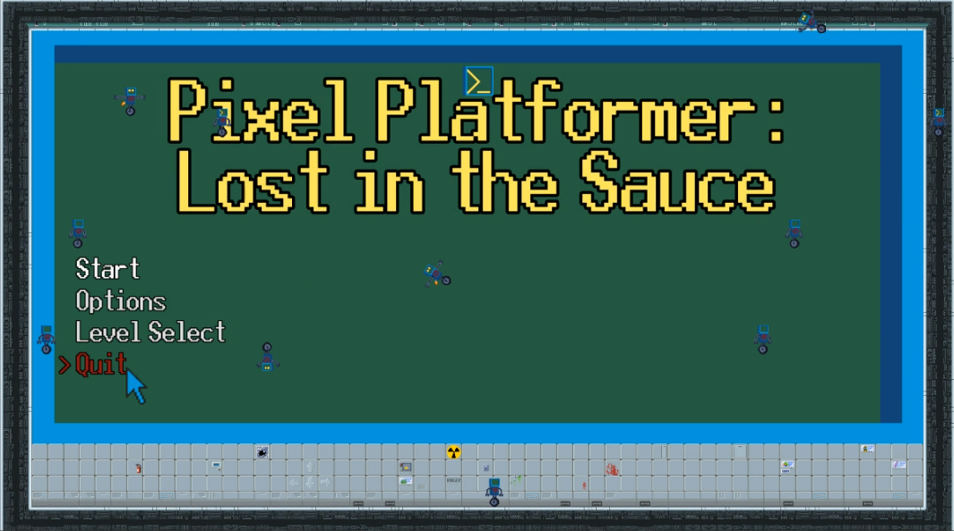
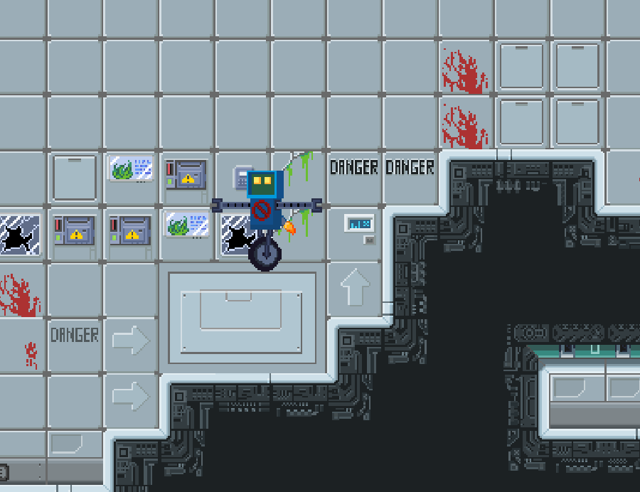

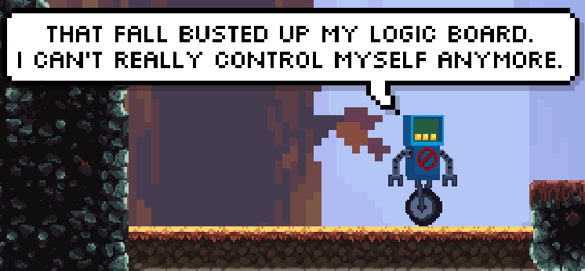
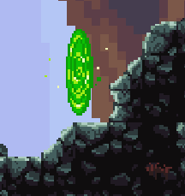
Screenies

Slide 10
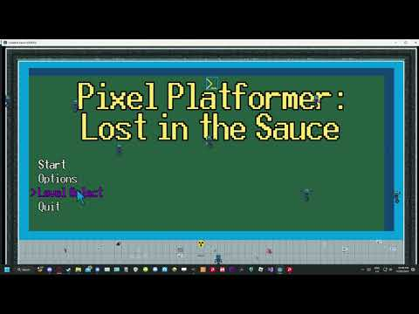
Video Runthrough

Slide 11
Open Source Resources Used(Assets)
Title | Source
Oak Woods — Environment Asset | https://brullov.itch.io/oak-woods
Pixel Platformer World | https://szadiart.itch.io/pixel-platformer-world
Platformer Fantasy Set 1 | https://szadiart.itch.io/platformer-fantasy-set1
2D Platformer Tileset - Laboratory | https://exceptrea.itch.io/2d-platformer-tileset-laboratory
2D Pixel Art Portal Sprites | https://elthen.itch.io/2d-pixel-art-portal-sprites
UI Buttons | https://kicked-in-teeth.itch.io/button-ui

Slide 12
Open Source Resources Used(Music)
Title | Source
HoliznaCC0 - Blue Skies | https://freemusicarchive.org/music/holiznacc0/lazy-summer-lofi-1/blue-skiesmp3/
HoliznaCC0 - Spring At Last | https://freemusicarchive.org/music/holiznacc0/spring-at-last-lofi-tape/spring-at-last/
Cagey House - Shadow Time | https://freemusicarchive.org/music/Cagey_House/Bottles_and_Bulletins/Shadow_Time_1063/
Steve Combs - Hero | https://freemusicarchive.org/music/Steve_Combs/Principal_Photography/Steve_Combs_-_Principal_Photography_-_01_Hero/
Schemawound - Self-Surgery Manual | https://freemusicarchive.org/music/Schemawound/Heart_Removal_kit/07-Schemawound-Self-Surgery_Manual/

Slide 13
Open Source Resources Used(Sounds)
Title | Source
True Ghost Break (180 BPM) | https://pixabay.com/sound-effects/true-ghost-break-180-bpm-102898/
Piano crash sound | https://pixabay.com/sound-effects/piano-crash-sound-37898/
Large crash with cat | https://pixabay.com/sound-effects/large-crash-with-cataiff-14490/
Notification Sound | https://pixabay.com/sound-effects/notification-sound-7062/
Wooden Thud (Mono) | https://pixabay.com/sound-effects/wooden-thud-mono-6244/
Soft Piano (100 BPM) | https://pixabay.com/sound-effects/soft-piano-100-bpm-121529/

